Slide 1
Day 4
TIME SERIES ANALYSIS CASE STUDY

Slide 2
INTRODUCTION TO TIME SERIES ANALYSIS
Time series analysis is a method that study the characteristics of the response variable with respect to time as the independent variable.
The time is use as the point of reference in order to make prediction and forecasting target variable.
Why using deep learning approach for time series analysis?
“Deep learning neural networks are able to automatically learn arbitrary complex mappings from inputs to outputs and support multiple inputs and outputs. These are powerful features that offer a lot of promise for time series forecasting, particularly on problems with complex-nonlinear dependencies, multivalent inputs, and multi-step forecasting.”
- Deep Learning for Time Series Forecasting Predict the Future with MLPs, CNNs and LSTMs in Python by Jason Brownlee-

Slide 3
Deep Learning with KNIME
KNIME is an open source software that composed of drag and drop nodes with each node has its own functionality.
In this workflow, we will go through all types of Time Series Analysis (TSA) using Long Short Term Memory (LSTM).

Slide 4
The 4 steps rule..
1
2
3
4
DATA LOADING & PREPROCESSING
MODEL ARCHITECTURE
MODEL TRAINING
MODEL EVALUATION
Data Analysis
Data processing to prepare input to deep learning model
Construct your model architecture

Slide 5
Univariate Multisteps Time Series Analysis using LSTM
Household Energy Consumption

Slide 6
WORKFLOW SUMMARY

Slide 7
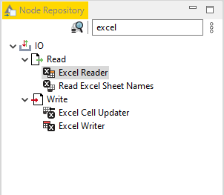
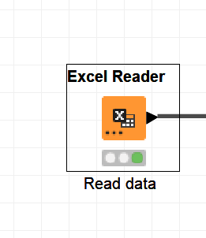
Step 1: Data Loading and Visualising
Every nodes can be found in the Node Repository. You may make use of the search bar to find the nodes you required.
Drag the excel reader node to the workflow area

Slide 8
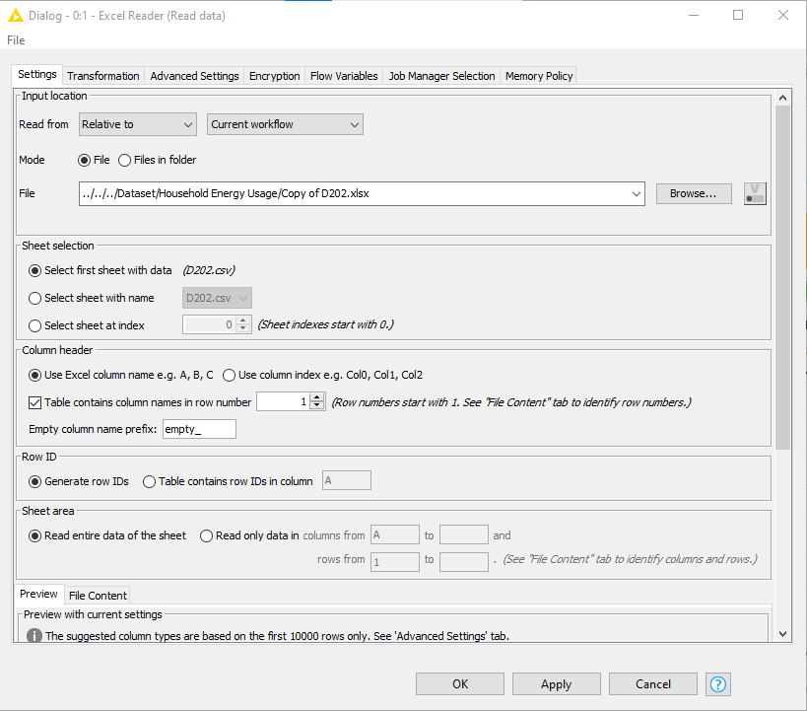
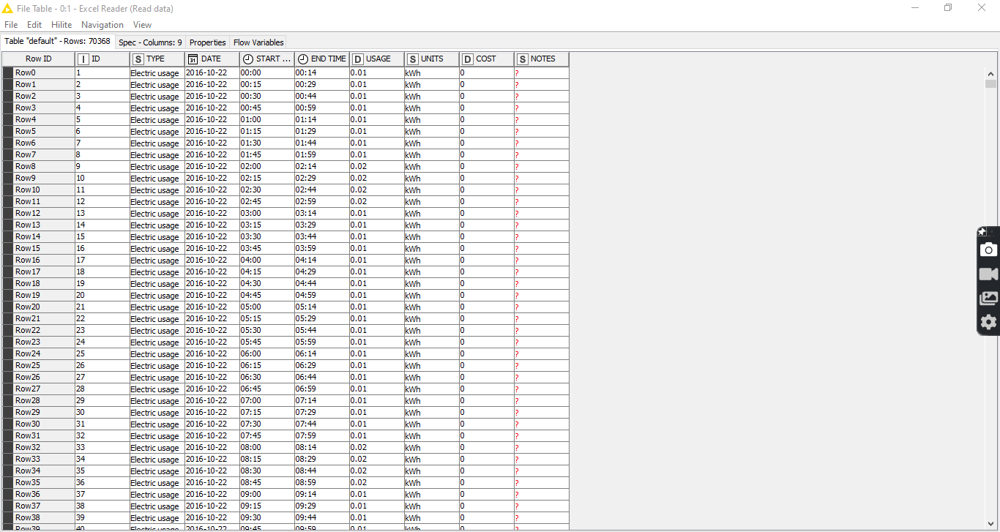
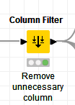
Double click on the nodes to configure. If everything is in order click Apply and OK
Execute the node and view the table. When you view the table you can foresee the columns you can filter out and columns you need to keep in. In this case study, column TYPE, UNITS, COST and NOTES are unessential.
Remove unnecessary column using
Column Filter Node

Slide 9
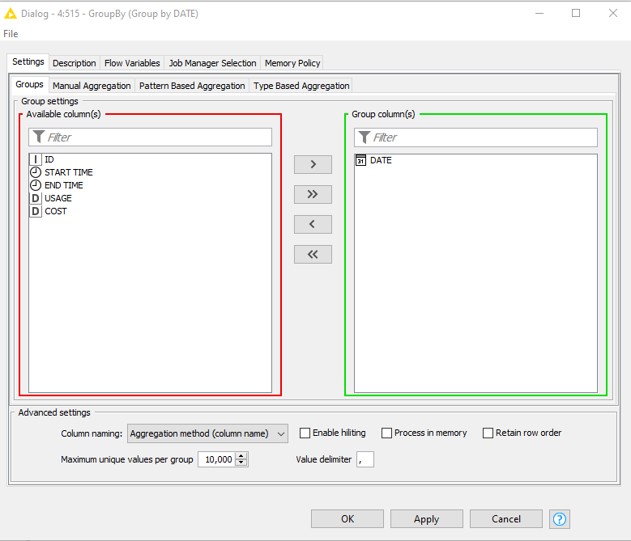
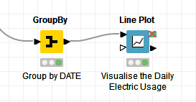
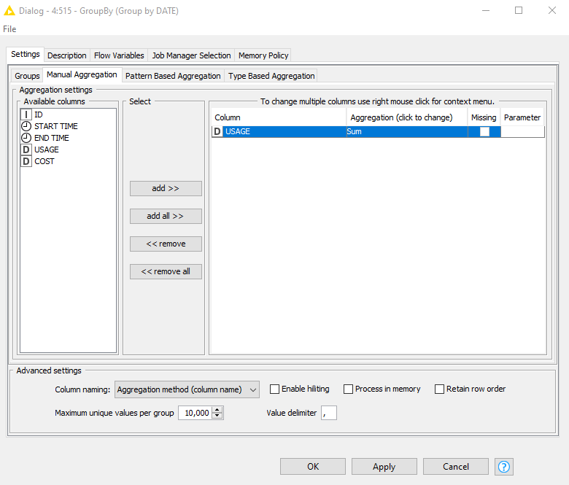
Step 2: EDA and Visualization
It’s important to do EDA and visualize your data to gain insight from the data before model training.
GroupBy Node configuration<groupby DATE<Manual Aggregation<USAGE(Aggregation Method=>Sum)
We want to plot Daily Total Energy Usage (kWH). GroupBy Node can be used to serve this purpose.

Slide 10
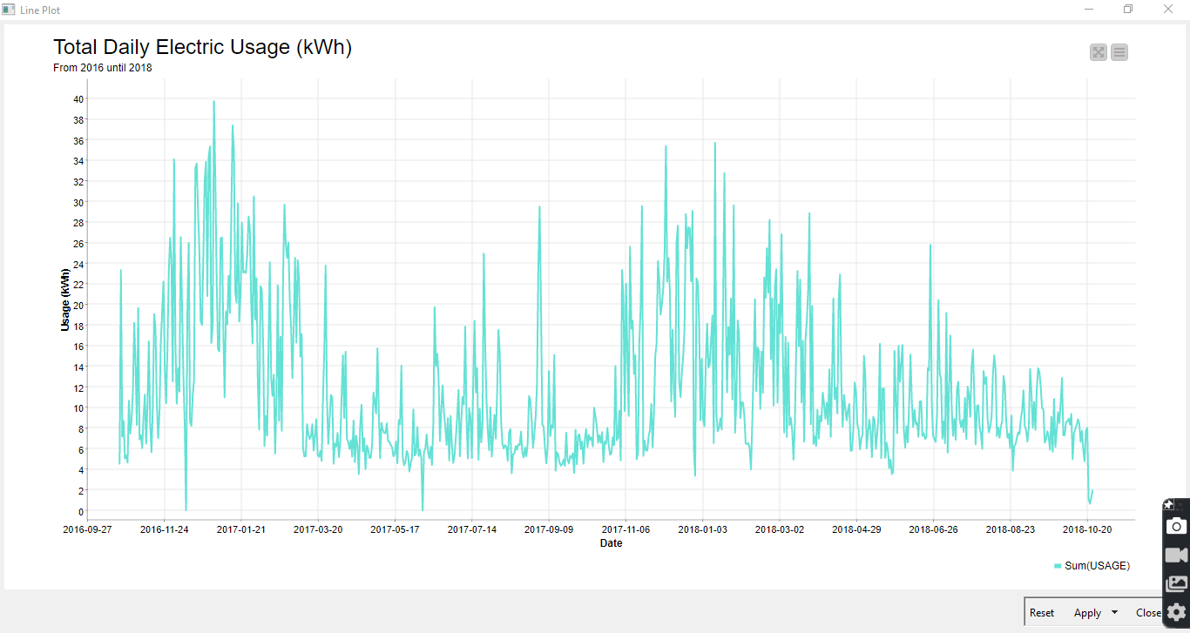
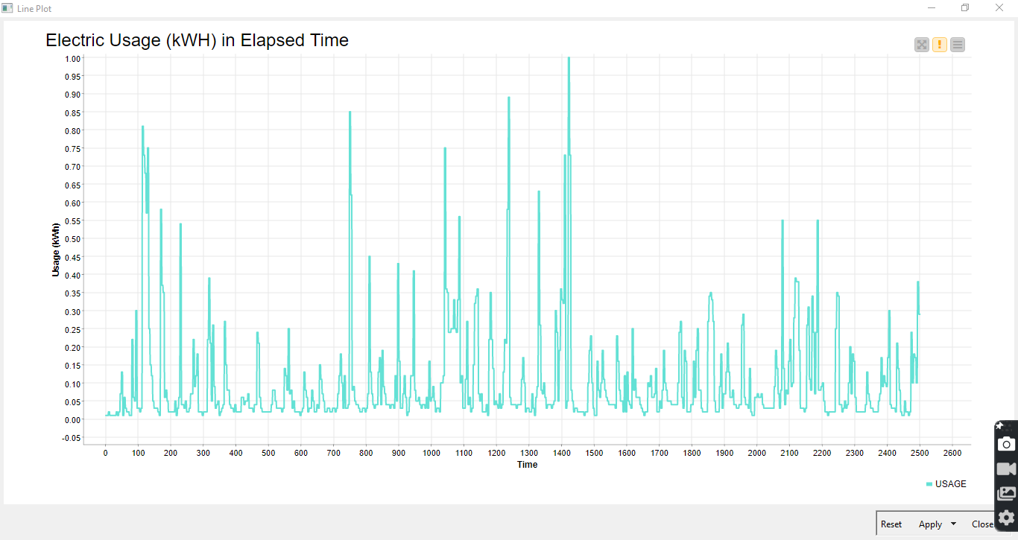
You can visualize the data using line plot. For time series data, line plot is usually beneficial as you can see the pattern and trend. For example in this chart you can see that the usage is fluctuated and non-linear. You can also observed the peak time of electric usage.

Slide 11
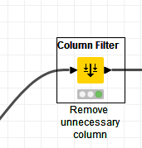
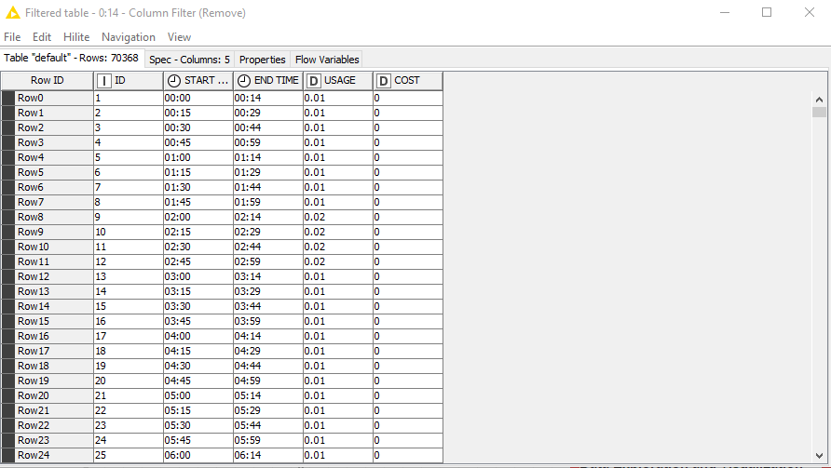
Step 3: Data Cleaning
You can remove DATE column since we will be forecasting Electric Usage using TIME. Since that we know the meter read electric usage for every 14 minutes, we will treat ID column as TIME ID for every 14 minutes meter reading.

Slide 12

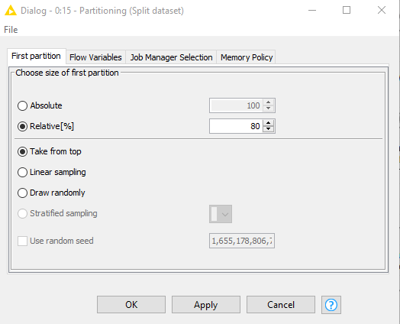
Step 4: Data Splitting/Partitioning
For data splitting, Partitioning node can be used. Data will be split to train and test set with 80:20 ratio.
In the configuration box, we will set Relative[%] to 80 for train set and the data will be split from the Top.

Slide 13
Step 5: Train/Validation/Test Data Processing (Building the input vector for Keras model)
The input to LSTM layer MUST be 3-dimensional. The three dimensions of this input are:
Samples - One sequence is one sample. A batch is comprised of one or more samples.
Time Steps - One time step is one point of observation in the sample. One sample is comprised of multiple time steps.
Features - One feature is one observation at a time step. One time step is comprised of one or more features.
The expected 3-dimensional structure of input data is often summarized using the array shape notation of [samples, timesteps, features]
In time series forecasting problems our features are observations at time steps. So, we are actually adding the dimension of features, where a univariate time series has only one feature.

Slide 14
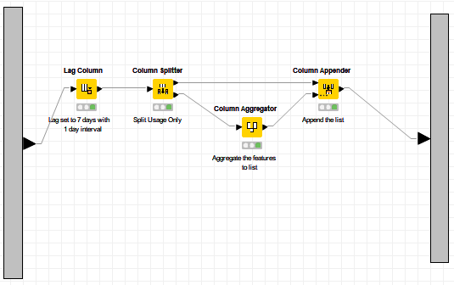
Transforming the a series of data to supervised learning

Slide 15
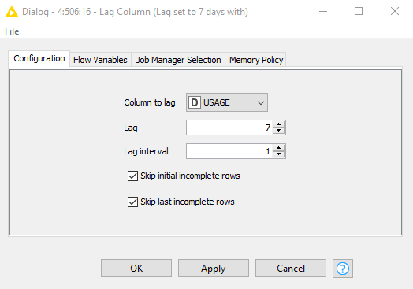
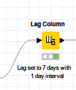
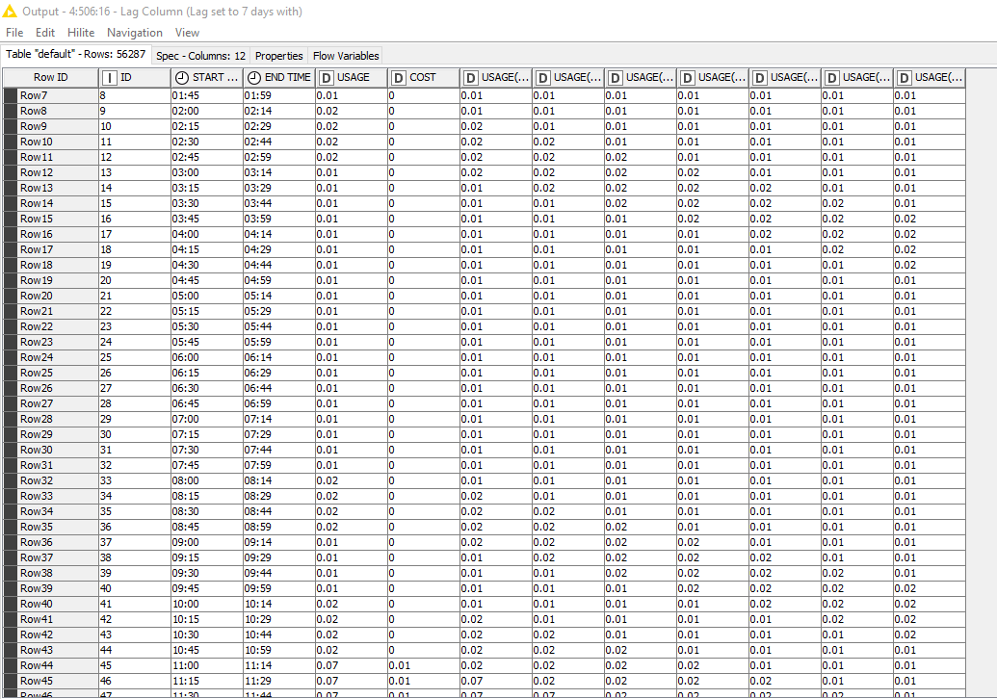
For this example, we are predicting electric usage for the next 7 days. Hence, we are adding time steps of 7 days for the USAGE column. For this purpose, Lag Column Node is used to set the desirable time step.
The configuration box of lag column
Output table
Notes:
Useful reading link : https://machinelearningmastery.com/how-to-develop-lstm-models-for-time-series-forecasting/

Slide 16

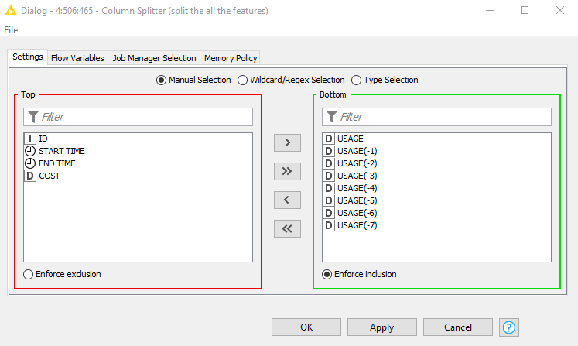
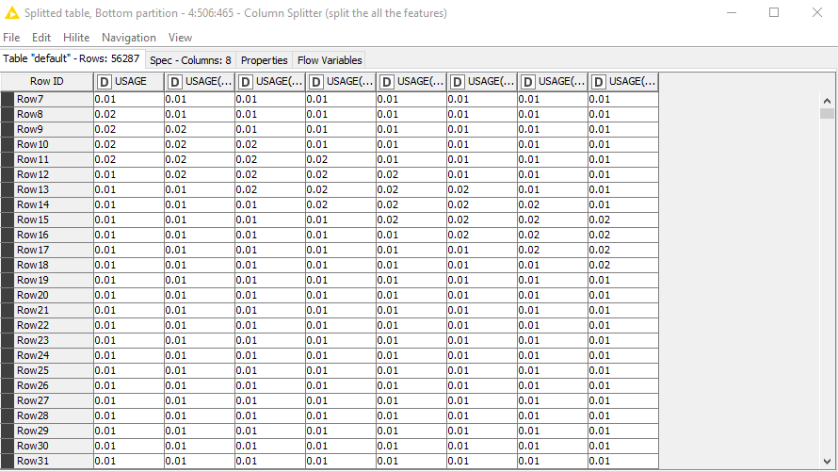
Column Splitter Node can be used to split your desire columns. In this case, we need to split the features[USAGE(-1 to-7)] and target column [USAGE].
Output table

Slide 17

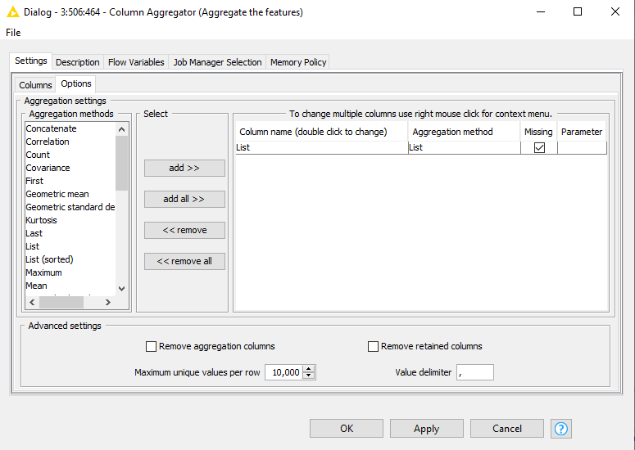
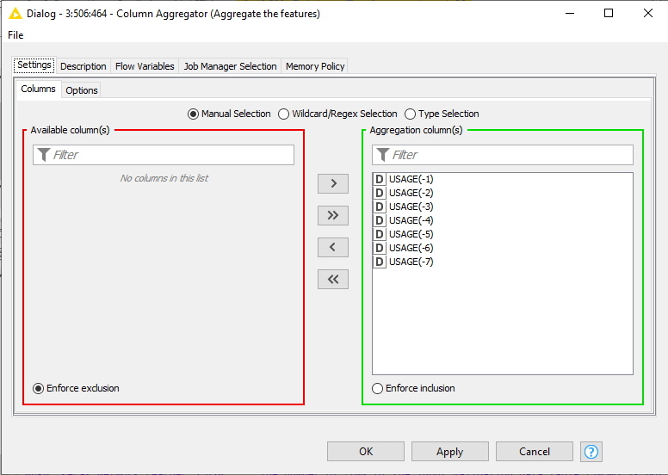
Column Aggregator grouped the selected columns per row and aggregates their cells using the selected aggregation method

Slide 18

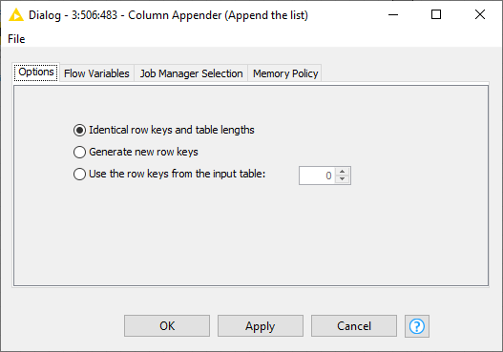
Column Appender takes two or more tables and quickly combines them by appending their columns according to the order of the tables at the input ports

Slide 19
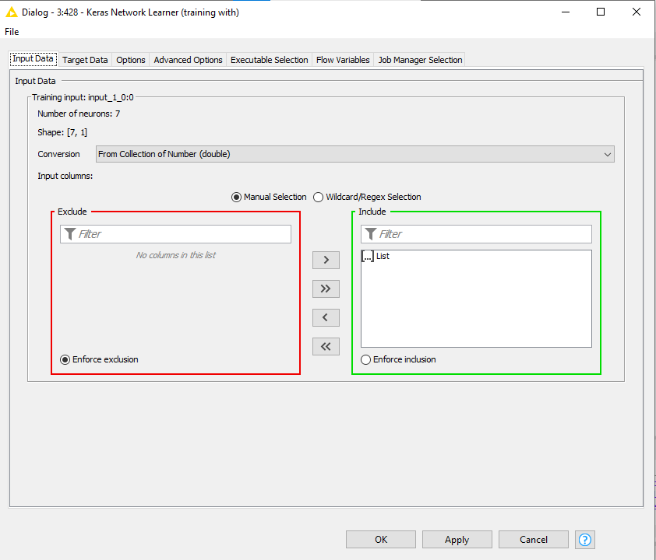
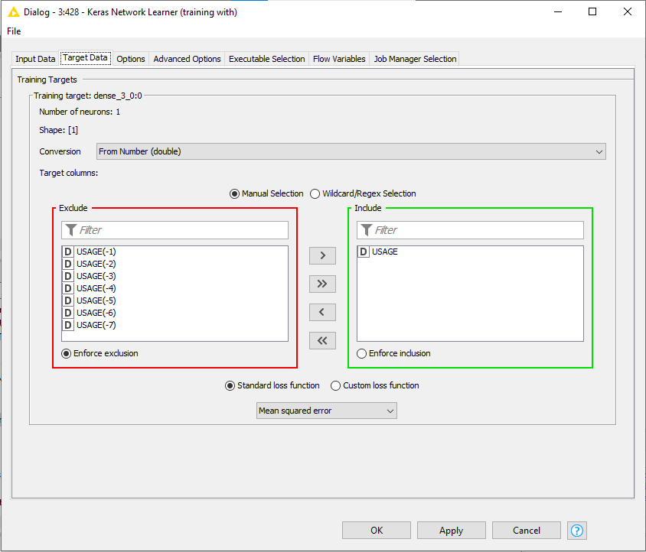
6. Model Training
Keras Network Learner - performs supervised learning on a Keras deep learning network.

Slide 20
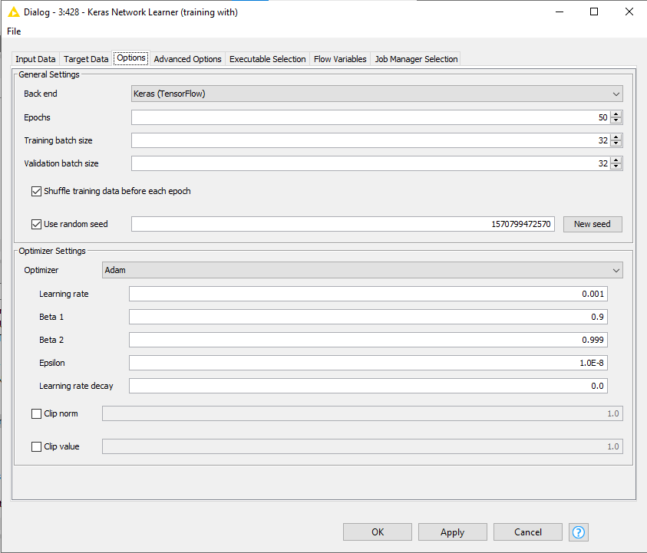
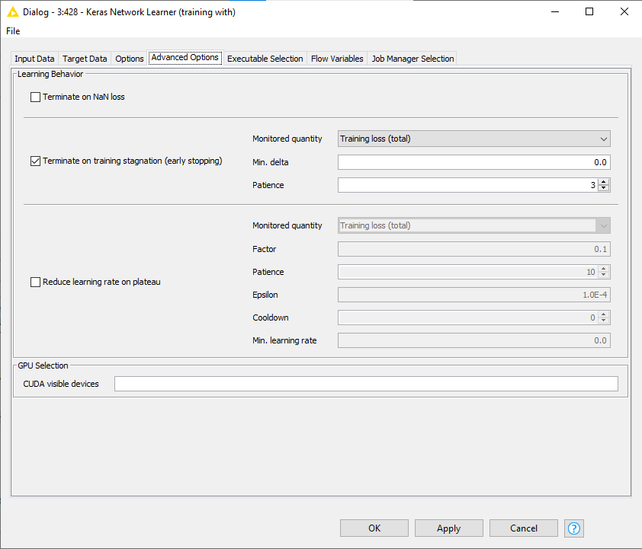

Slide 21
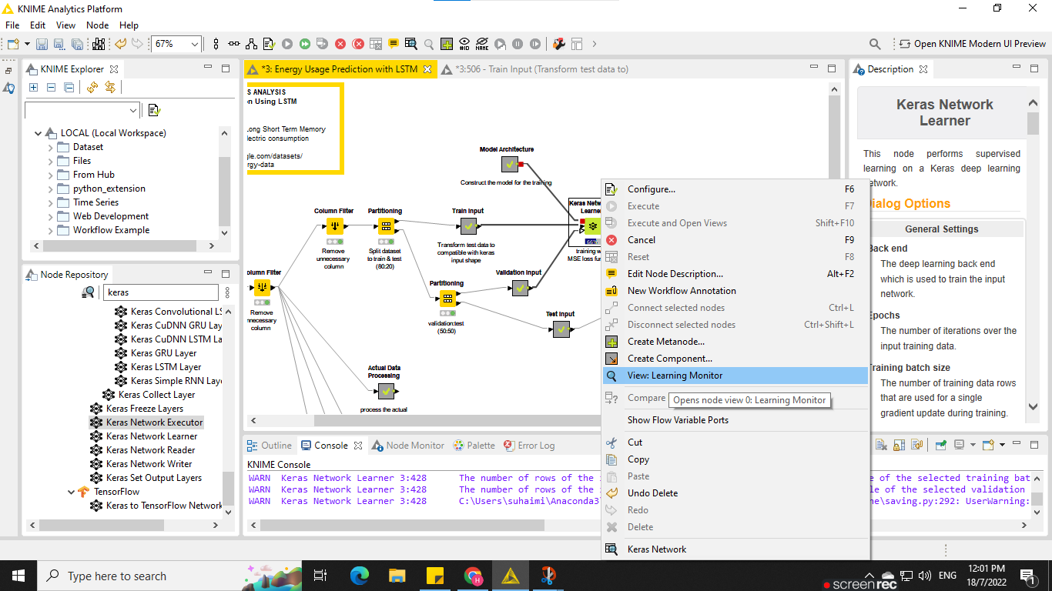
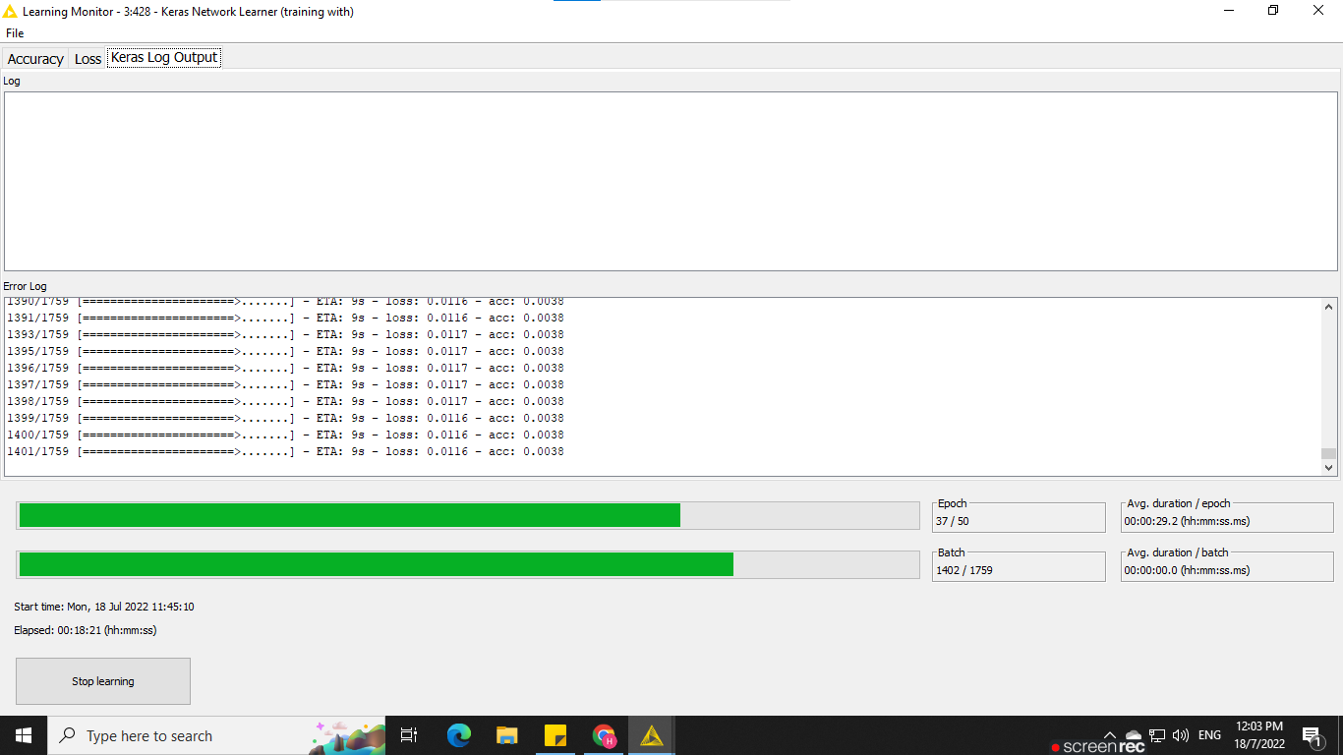

Slide 22
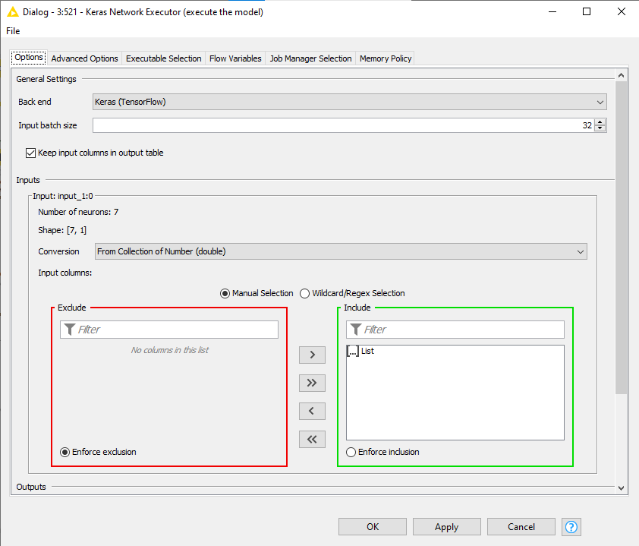
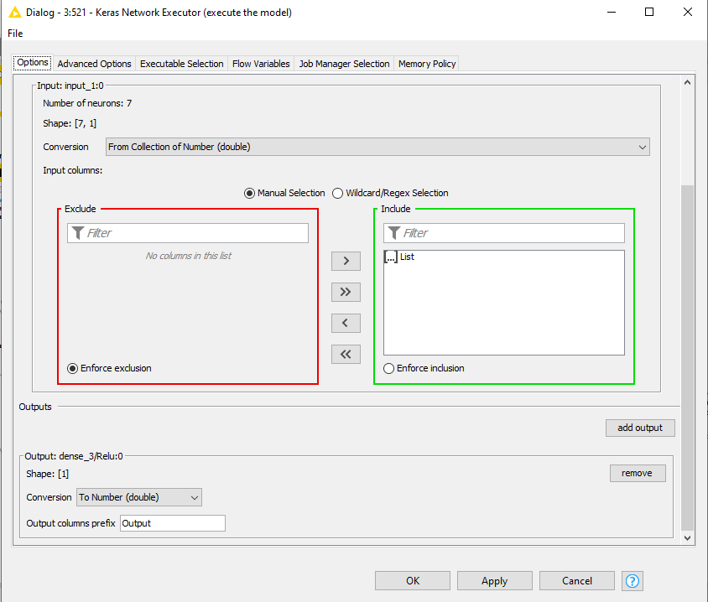
7. Model Executor
Keras Network Executor - executes a Keras deep learning network on a compatible external back end that can be selected by the user.

Slide 23

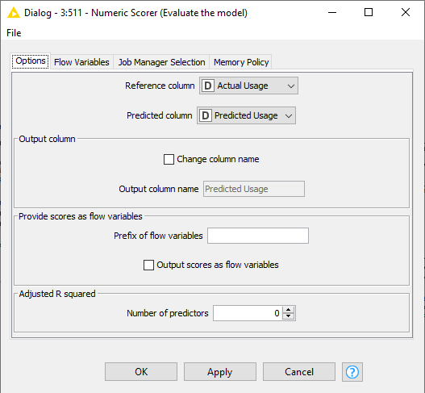
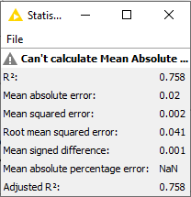
8. Model Evaluation Metrics
Numeric Scorer - This node computes certain statistics between the a numeric column values (r i ) and predicted (p i ) values
Output
Notes:
https://analyticsindiamag.com/a-guide-to-different-evaluation-metrics-for-time-series-forecasting-models/

Slide 24
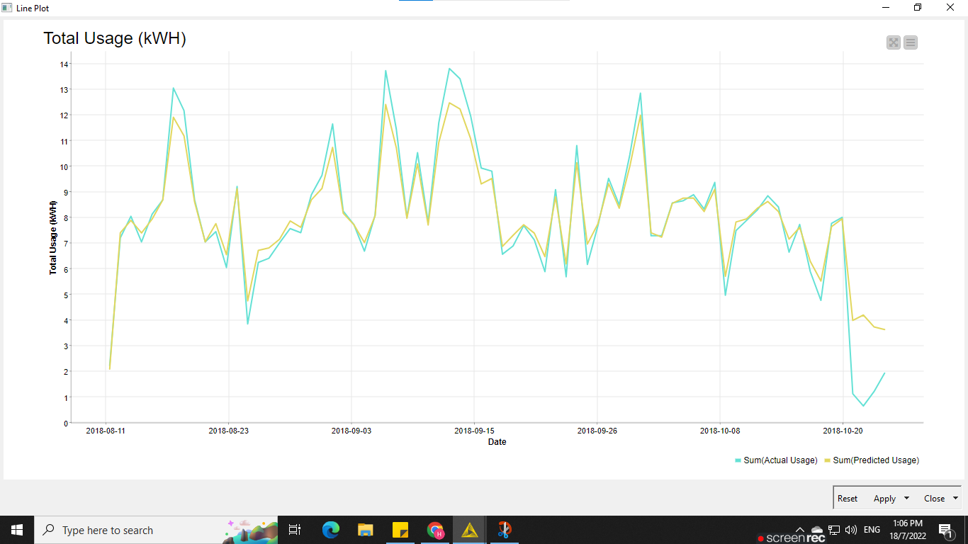

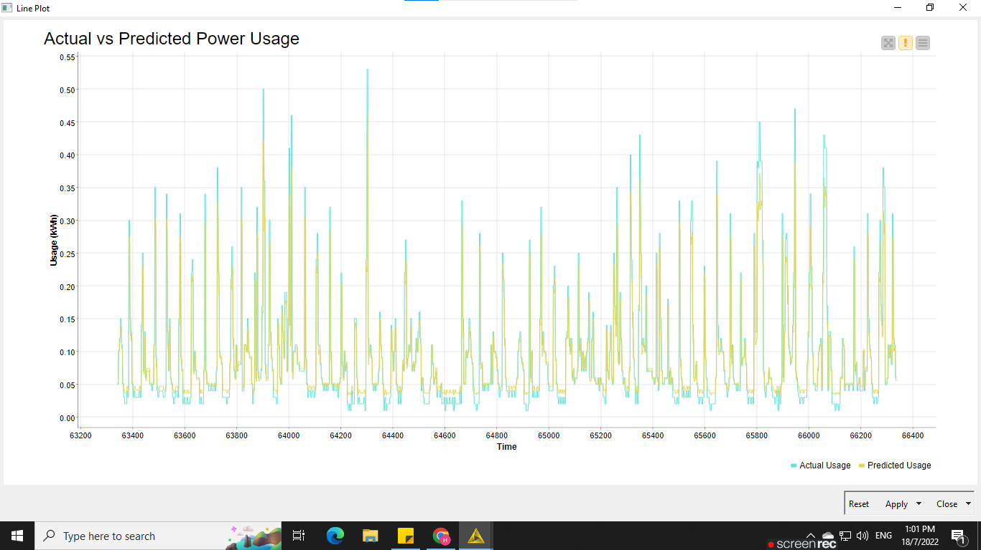
9. Visualization the Actual Vs Predicted Power Usage

Slide 25
Bivariate Multisteps Time Series Analysis using LSTM
Windmill Energy Production

Slide 26
WORKFLOW SUMMARY
Data Loading & preprocessing

Slide 27
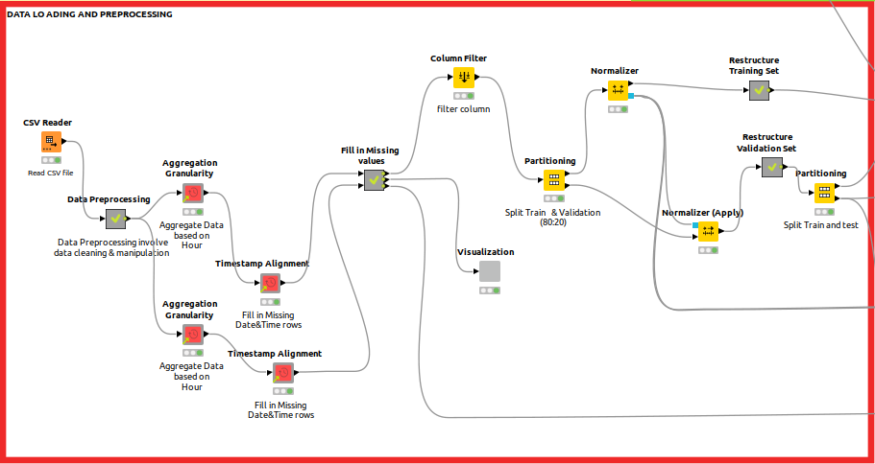
Data Loading & Preprocessing

Slide 28

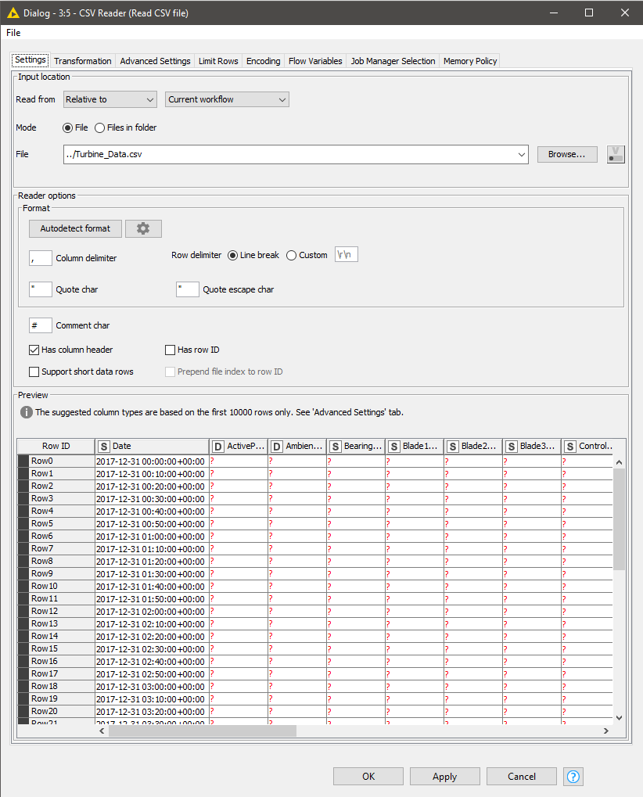
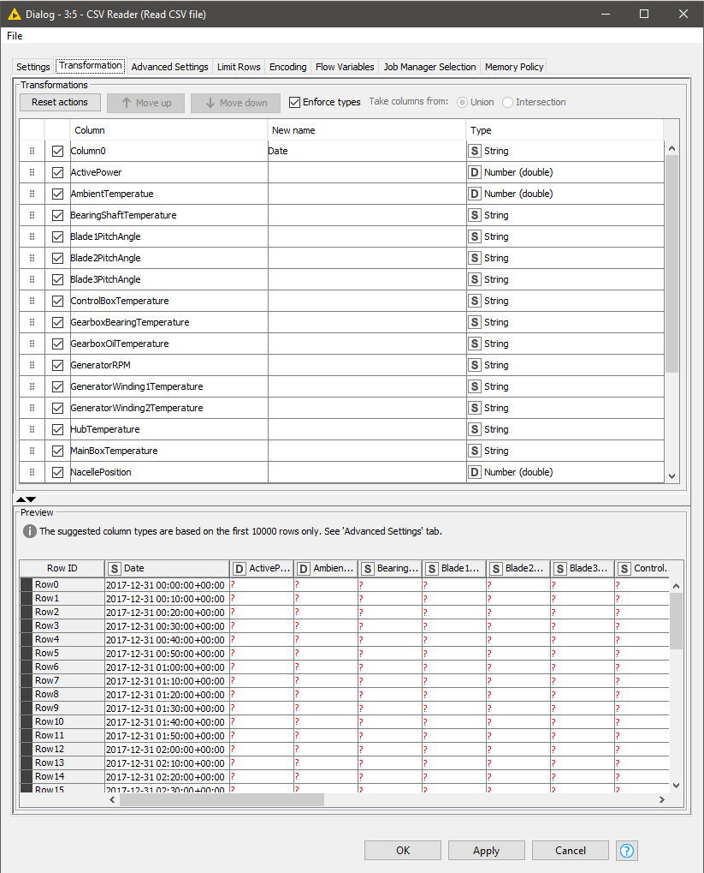
Step 1: Data Loading and Visualising

Slide 29
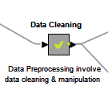
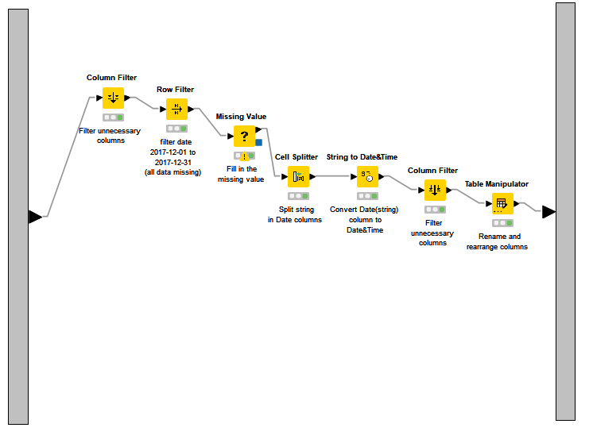
Step 2: EDA and Visualization
Column filter - remove all unnecessary column for the TSA
Row Filter - remove all Dec-2017 data
Missing Value - fill in missing value for both column
Cell Splitter - split char”+” in date(string)
String to Date&Time - convert date(string) to datetime format
Column Filter - filter the unnecessary column
Table Manipulator - Rename & rearrange columns
Metanode for data cleaning

Slide 30
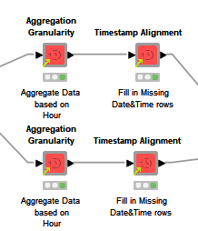
Step 2: EDA and Visualization
Knime has verified component for TSA that we can make use of. For this purpose, Aggregation Granularity and Timestamp Alignment can be used.
Aggregation granularity aggregates values in a selected numeric or string column by timestamps extracted from a column of type Date&Time.
Timestamp Alignment checks whether the selected timestamp column is uniformly sampled in the selected time scale. Missing values will be inserted at skipped sampling times.

Slide 31
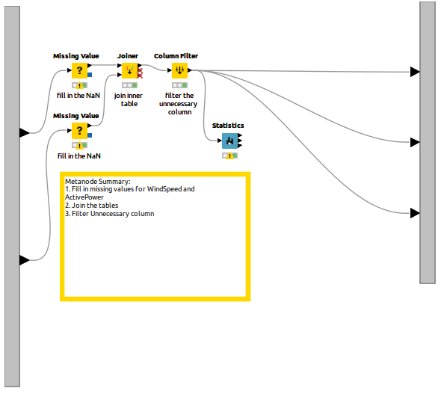
Fill in missing values for both WindSpeed and ActivePower
Join the table
Filter the unnecessary column

Slide 32
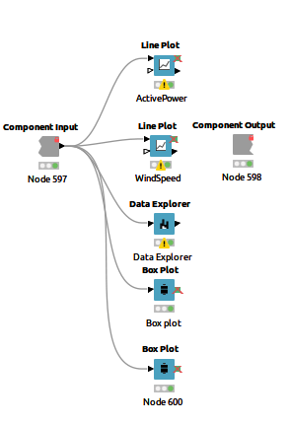

Slide 33
Multivariate Multisteps Time Series Analysis using LSTM
Pollution prediction

Slide 34
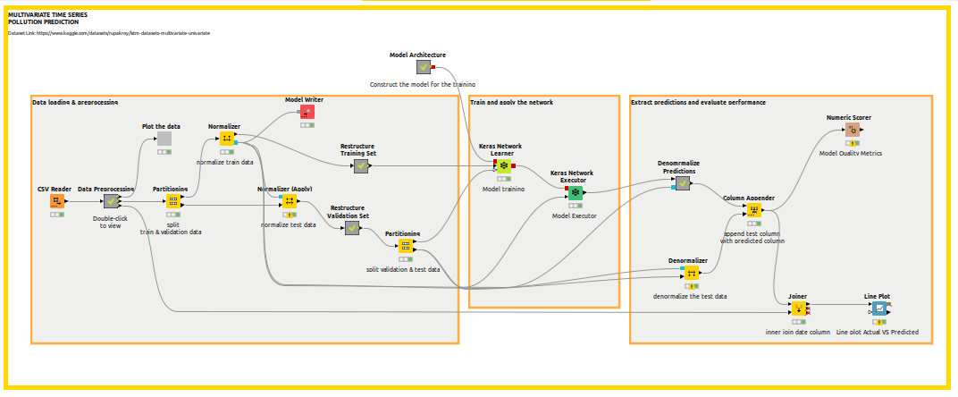
Workflow Summary

Slide 35
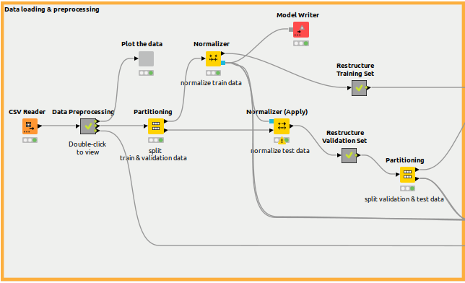
Data Loading & Processing Stage
Data loading using CSV reader node
Data preprocessing (refer to next slide)
Data visualization
Training and validation dataset using partitioning node
Normalize both training and validation dataset using normalizer node
Prepare input vector for keras model training
Then, partition the validation data to validation and test data

Slide 36
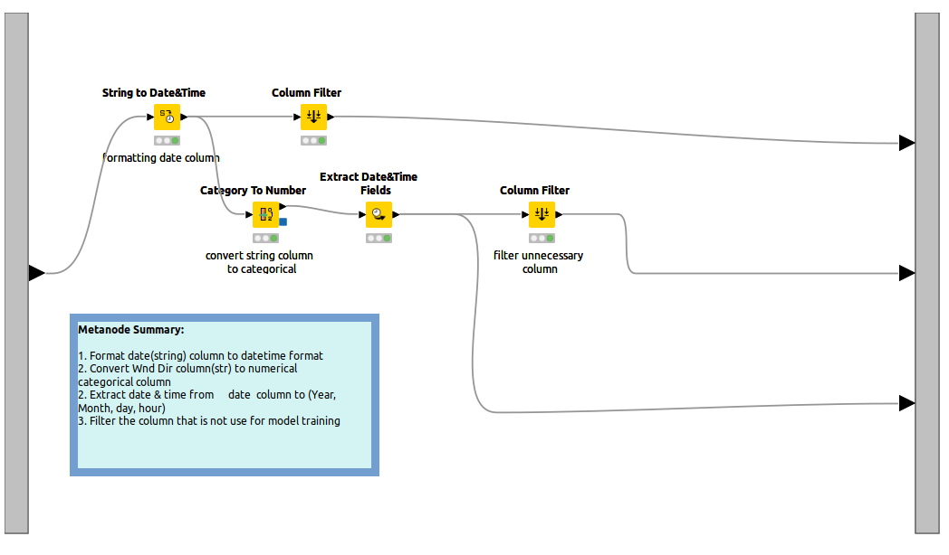
Data Loading & Processing Stage

Slide 37
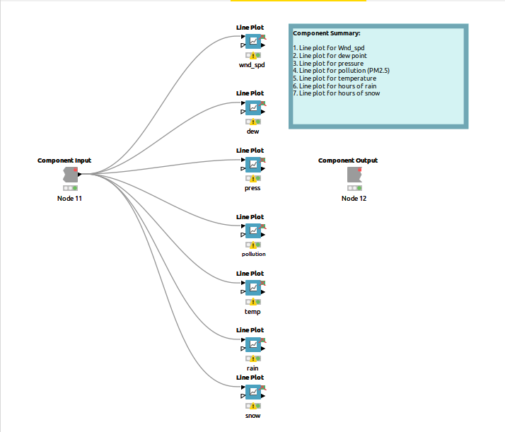
Data Loading & Processing Stage - Visualization

Slide 38
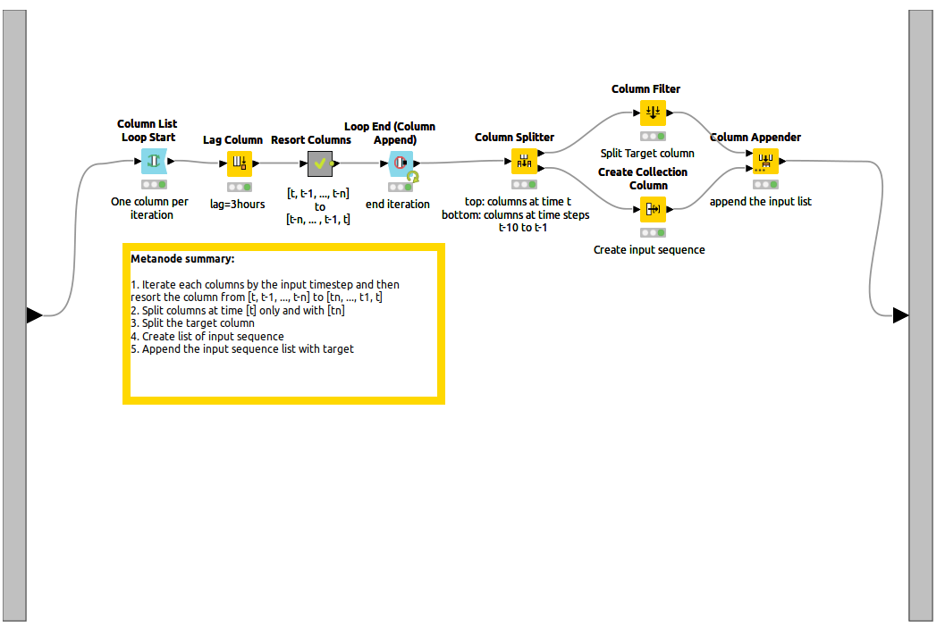
Data Loading & Processing Stage - LSTM input shape preparation
The input of every CNN and LSTM layer must be in 3-d shape with the shape of [samples, timesteps, features]
In this workflow we are going to train the model to predict the pollution in the next 3 hours hence we need to iterate every each of features by 3 timesteps.
To do this, we can utilize the lag column node to add each features/columns by 3 timesteps and iterate all columns over using Column List Loop Start & Loop End (Column Append) nodes.
We need to resort the columns backward from [t, t1, …, tn] to [tn, …, t2, t1] since that we are teaching the model to be able learn from past historical data.
Column splitter is used to split all features with the 3 timesteps to the original data.
Column filter is used to split our target column in this case pollution column
Then we can transform all the features with 3 timesteps to list by using Create Collection Column node, then append target column and input sequence

Slide 39

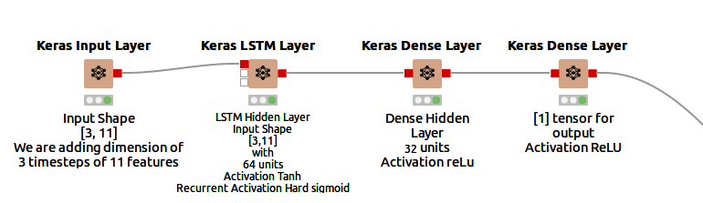
Building Model Architecture

Slide 40
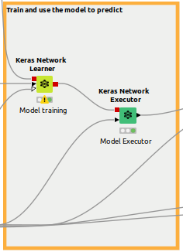
Model Training & prediction
Keras Network Learner is used for Model Training with batch size of 64 and epochs set to 50. Early stopping is implemented to avoid overfitting by monitoring training loss with patience of 3.
Then, the trained model can be applied for prediction using keras network executor

Slide 41
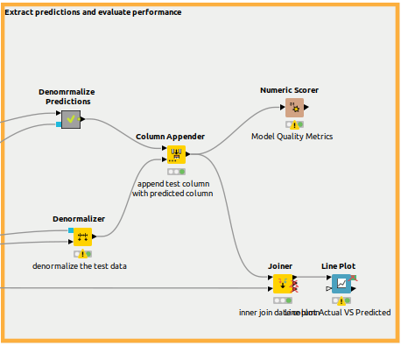
Evaluate Model performance
Both test data and predicted value need to denormalize
Note that denormalizer node only worked with the column name must be same as the normalized column.
Then, append the predicted value and test data to evaluate the model performance using Numeric Scorer Node
Then, visualize the Actual vs Predicted Line Plot

Slide 42
End of slides

